Slide 1

Desi Bazaar
Group 6
Varda Laud
Sai Sarath K
Akshay Bodhankar
Nachiket Doke
May 4, 2015

Slide 2
Introduction
We have build an E-Commerce website.
Basic Goal
To provide users a platform to sell and buy items through bidding.
Intended users
Anyone who wishes to sell or buy an item online.

Slide 3
Scope and Objectives
Seller posts items for bidding.
Users can view current auctions which are in ToStart and Active stage.
Buyers can subscribe and later bid for the ongoing/forthcoming auctions.
Buyers can give rating and review for their purchases.

Slide 4
Technologies Used
Maven
Apache Maven is a software project management and comprehension tool. Based on the concept of a project object model (POM), Maven can manage a project's build, reporting and documentation from a central piece of information.
Spring MVC
The Spring Framework is a Java platform that provides comprehensive infrastructure support for developing Java applications. It provides features like Dependency Injection and Inversion of Control and Aspect Oriented Programming. The Spring Web model-view-controller (MVC) framework is designed around a DispatcherServlet that dispatches requests to handlers, with configurable handler mappings. The default handler is based on the @Controller and @RequestMapping annotations, offering a wide range of flexible handling methods. The @Controller mechanism allows you to create RESTful Web sites and applications through the @PathVariable annotation and other features.

Slide 5
Continued
Hibernate
Hibernate is an object-relational mapping framework for Java language, providing a framework for mapping an object-oriented domain model to a traditional relational database.
Quartz Scheduler
Quartz is a richly featured, open source job scheduling library that can be integrated within virtually any Java application.
log4j
Apache log4j is a Java-based logging utility.

Slide 6
Front End
AngularJS:
AngularJS is an open-source web application framework for developing single-page applications. It follows client-side model–view–controller (MVC) architecture.
Bootstrap CSS:
Bootstrap is the most popular HTML, CSS and JavaScript framework for developing responsive web sites.

Slide 7
Testing
Unit Testing:
JUnit is a unit testing framework for the Java programming language and plays an important role in test-driven development.
Mockito framework allows the creation of test double objects (mock objects) in automated unit tests for the purpose of Test-driven Development (TDD) or Behavior Driven Development (BDD).
Hamcrest is a framework that assists writing software tests in the Java programming language. It supports creating customized assertion matchers, allowing match rules to be defined declaratively. These matchers have uses in unit testing frameworks such as JUnit and jMock.
Selenium WebDriver:
Selenium WebDriver is a software testing framework to automate UI test cases for web applications.

Slide 8
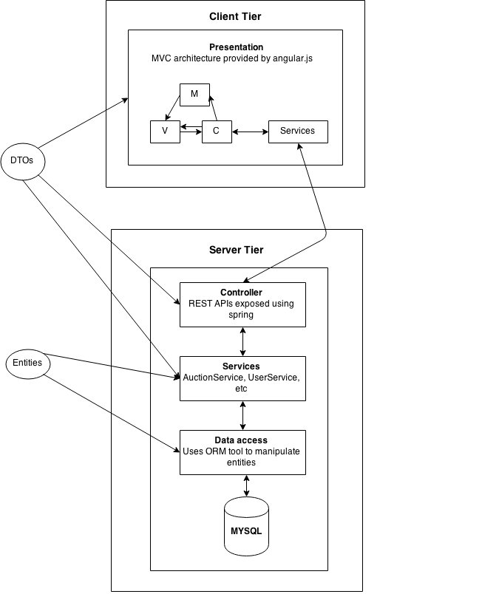
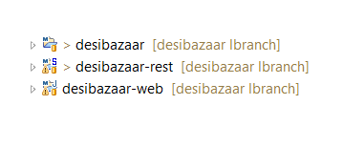
Project Structure and Architecture

Slide 9
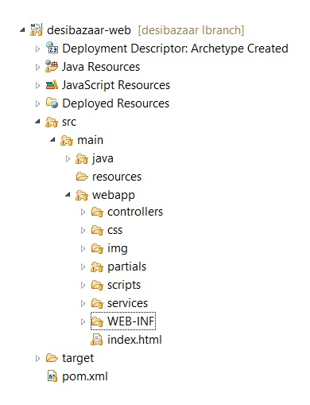
Client Project Structure

Slide 10
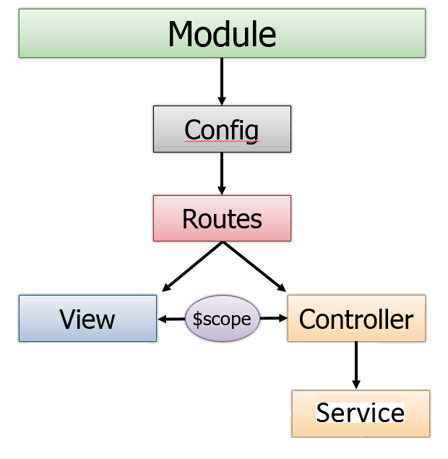
Client Modules

Slide 11
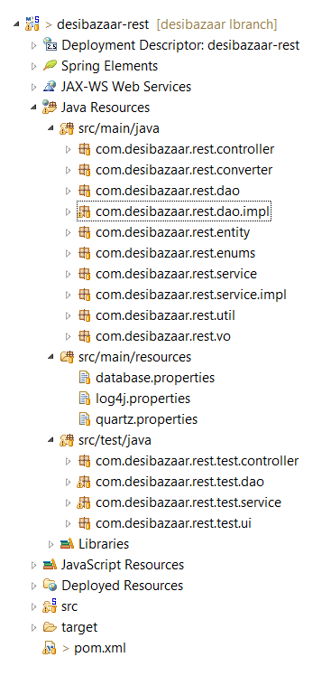
Server Project Structure

Slide 12
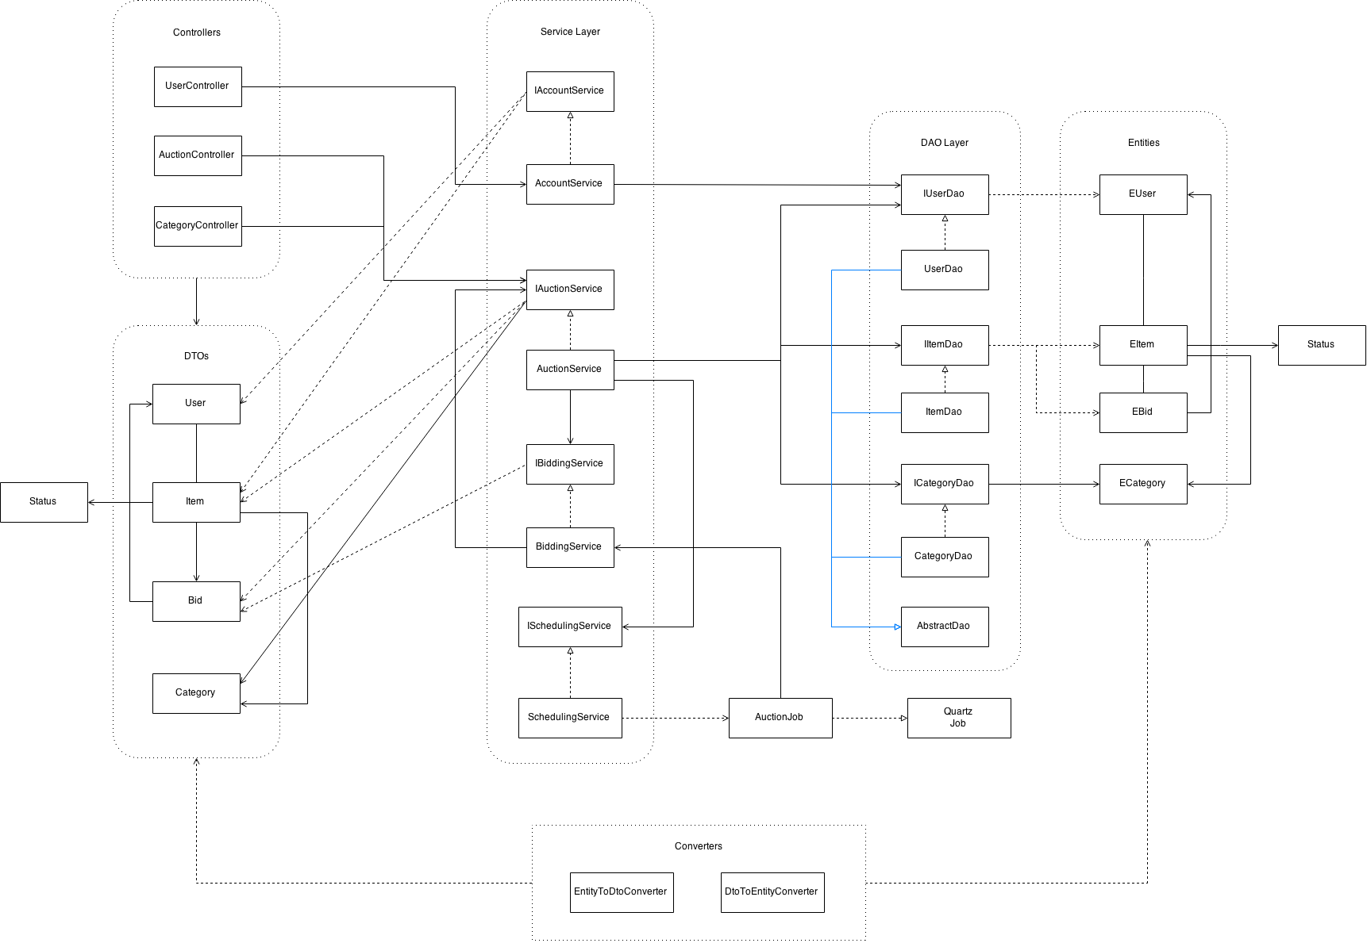
UML Diagram

Slide 13
Project Retrospective

Slide 14
Aspects that worked well
Agile technology was new, lot to learn.
Time spent in learning the new technologies.
Working together at the same time. (Github)
Knowledge sharing and helping each other out.
Industry-like experience.
Getting to know new people.

Slide 15
Issues faced by the team
New technologies.
Time crunch.
Improper goal estimation
Co ordination issues
Meeting time issues.

Slide 16
Resolution of issues
Online tutorials for learning
Starting work early in the later sprints
Making piecemeal tasks
Effectively used WhatsApp for co-ordination
Fixed time slot for every week.

Slide 17
Future Scope
Recommendations based on previous purchases.
Filters on the price, category, rating.
Payment system.
Live auctions.
Asking questions to the previous buyers.
Selling of products.

Slide 18
Thank You !

Slide 19
Any Questions?

